Slide 1

Manually Testing on Fortune Cloud Technologies (https://fortunecloudindia.com)
Mentor Pratiksha Mam
Sucheta Kadupatil (TL)
Trupti Vaidya (TM)
Samarth Tarlekar(TM)

Slide 2
Explanation of Project
What is Fortune Cloud Technologies is an IT training and placement institute that provides industry-focused courses to help individuals build careers in the IT sector. The institute has been operational for over 9 years, expanding its training facilities and partnering with 2,000+ reputed IT companies to ensure job placements for students.
Main Modules of Fortune Cloud Technologies
1.Course – Displays available training programs, course details, syllabus, and brochure downloads. 2.Discover – Provides information about the company, including About Us, Blog, Gallery, and Contact sections. 3.Technical Videos – Offers educational and training videos related to IT courses. 4.Reviews – Showcases student testimonials, video reviews, and success stories.
Who can make use of the website
1.Students & Freshers – For IT career training & placements. 2.Working Professionals – To upskill in IT technologies. 3.Job Seekers – To switch careers into IT. 4.Corporates – For employee training programs. 5.Entrepreneurs & Freelancers – To learn Digital Marketing & Web Development.

Slide 3
Roles and Responsibilities
Project Done By : Trupti Vaidya, Sucheta Kadupatil and Samarth Tarlekar.
Functions Performed by Trupti : Course: Discover, Technical Videos and Reviews.
Functions Performed by Sucheta : YouTube , Facebook , Instagram , LinkedIn, WhatsApp Calling , WhatsApp Messages , Upcoming Batches , Quick Enquiry( Name , Email , Contact , Course interested in , Select Branch) , Courses , Free Demo Session .
Functions Performed by Samarth : Student Login and Footer Section.

Slide 4
Modules Tested By Trupti
1.Course
Full Stack Development
Mern Stack Development
Software Testing
Cloud Computing
Data Science and Data Analytics
Digital Marketing
Web Development
2.Discover
About Us
Blog
Gallery
Contact
3.Technical Videos
4.Reviews

Slide 5
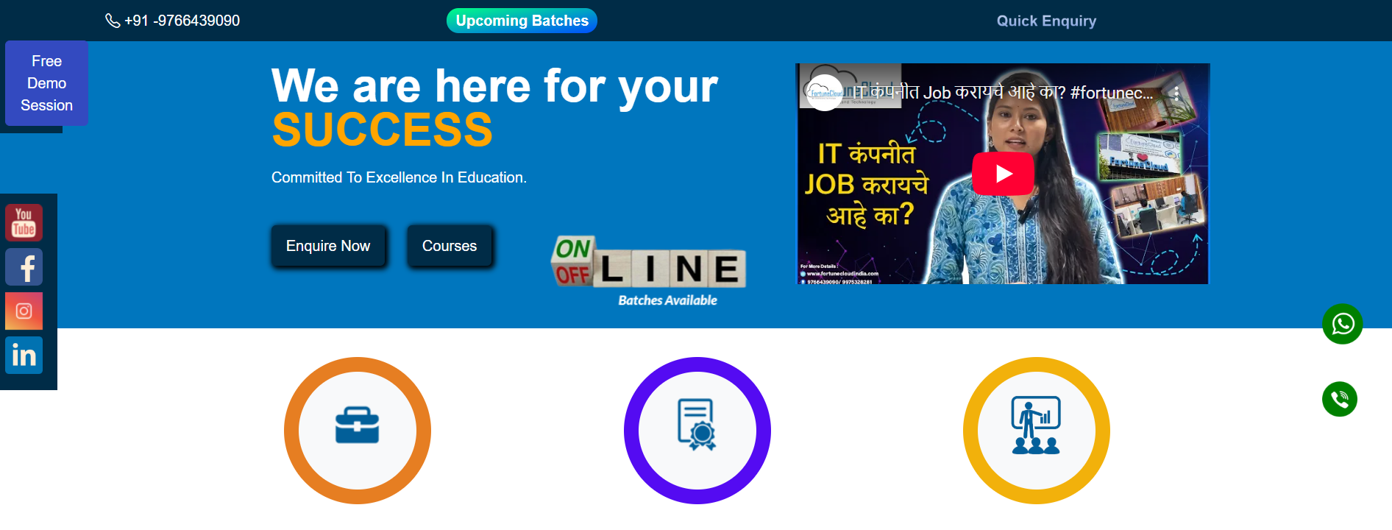
Modules Tested By Sucheta
YouTube
Facebook
Instagram
LinkedIn
WhatsApp Calling
WhatsApp Messages
Upcoming Batches
Quick Enquiry
Name
Email
Contact
Course interested in
Select Branch
Courses
Free Demo Session

Slide 6
Modules Tested By Samarth
Footer
Office
a. Cloud
B.Mca
c.Devops
D.terraform
E. Kubbernet
F.docker
G.java
H.pythonI.
j.asp.net
L. Manual
M. Automation
N. Terms and condition
O. Privacy and policies
P. Refund policy
Q. Quick info
Student login
a. Username field
b. password field
C. login button
D. fogot password link
E. error message
F. free aptitude series
G. lms playlist
H. apk download

Slide 7
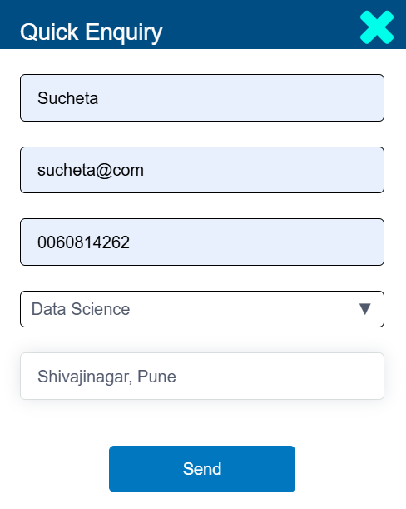
Bug/Defect Report
Function : Quick Enquiry
Scenario : Verify the Email field accepts a valid email format.(Correct format – sucheta@gmail.com)
Test Case ID : TC_0034
Severity : Critical
Priority : Urgent
Accepting Invalid Email format

Slide 8
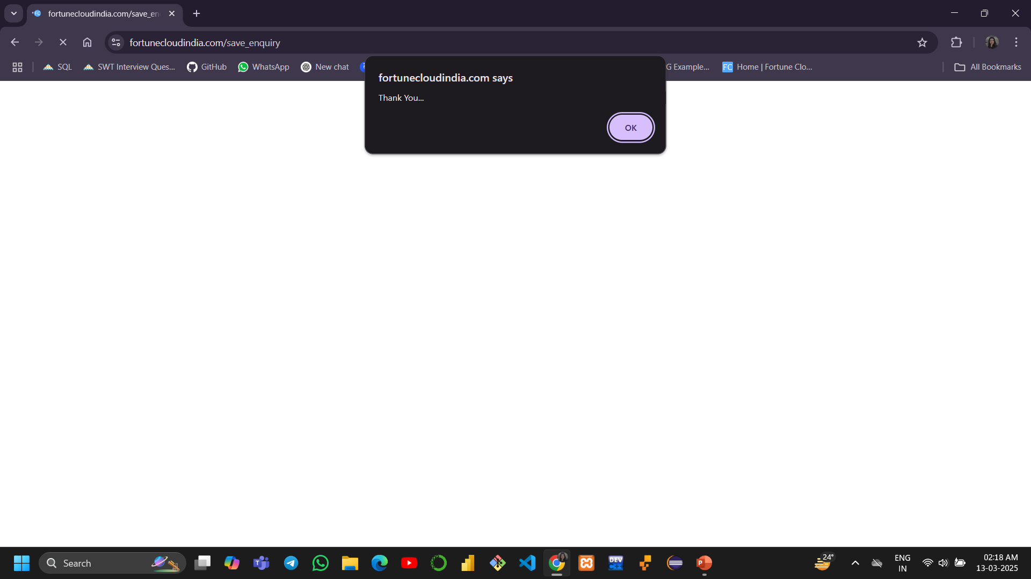
Successfully accepting Form ( Email – sucheta@com )

Slide 9
Challenges
Basic challenge I faced during this project that it was very Time-Consuming

Slide 10
Experience
Testing the Fortune Cloud Technologies website was a hands-on learning experience that helped me understand real-world testing challenges.
As I navigated through different sections like Courses, Discover, and Reviews, I identified issues such as broken links, slow page loads, and validation errors, which made me realize the importance of attention to detail.
This experience sharpened my observational skills, problem-solving abilities, and defect reporting techniques, making me more confident in manual testing and eager to explore automation testing next.

Slide 11
Thank You
I would like to express my heartfelt gratitude to everyone who supported me throughout this project. Special thanks to my Teammate Samarth and trupti, My Mentor Pratiksha mam. Thank you so much for your valuable guidance and encouragement. Your support has been invaluable in making this project a success.

